Slide 1
IBM University Engagement Project Submission
“Exploring the Power of Agentic AI with IBM Granite and IBM Bob”

Slide 2

Project Tile – [SAVORIA: An AI-Powered RAG-Based Intelligent Recipe Preparation Agent for Personalized, Ingredient-Based Meal Preparation]
Domain of Project – [Artificial Intelligence /Agentic AI / Food Technology]
Student Name | Recent Passport Photo | Email ID | Mobile number [WhatsApp]
Harini D |  | harinidurai621@gmail.com | 6369941877
Recommended font style and size:
Font Style: Arial
Font Size (Heading): 28
Font Size (Content): 20

Slide 3
Problem Statement – 16. Recipe Preparation Agent
THE CHALLENGE
Many people have groceries available at home but struggle to decide what meals they can prepare with them. Finding suitable recipes, identifying ingredient substitutions, and adapting meals to dietary preferences can be time-consuming.
THE OBJECTIVE
Build an AI-powered Recipe Preparation Agent that uses RAG to retrieve relevant recipes and generate personalized meal suggestions based on available ingredients, preferences, and dietary restrictions.
KEY OBJECTIVES
• Ingredient-Based Recipe Suggestions Recommend practical recipes using ingredients already available.
• RAG-Based Recipe Retrieval Retrieve relevant recipes and cooking knowledge before generating recommendations.
• Personalized Meal Preparation Adapt recipes according to cuisine, meal type, cooking time, servings, and user preferences.
• Ingredient Substitution Suggest suitable alternatives when required ingredients are unavailable.
• Dietary Adaptation Adjust recipes according to dietary preferences or restrictions.
• Food-Waste Reduction Help users make better use of existing groceries and reduce unnecessary food waste.

Slide 4
Proposed Solution -
PROPOSED SOLUTION: AI-POWERED RECIPE PREPARATION AGENT
SAVORIA is an AI-powered RAG-based Recipe Preparation Agent that transforms available groceries into practical, personalized meal solutions.
The system retrieves relevant recipes and cooking knowledge from a curated knowledge base and uses IBM watsonx.ai to generate recipes adapted to the user's ingredients and preferences.
KEY COMPONENTS
• Ingredient Analyzer
Understands available ingredients and user requirements.
• Recipe Retriever
Uses RAG to retrieve relevant recipes and cooking information.
• Recipe Generator
Creates personalized step-by-step recipes using the retrieved context.
• Substitution Advisor
Suggests suitable alternatives for unavailable ingredients.
• Dietary Adaptation
Adjusts recipes according to user preferences and dietary restrictions.
• Cooking & Feedback Module
Provides structured preparation steps, cooking tips, and practical guidance.
The solution helps users save time, use available groceries effectively, and reduce food waste through intelligent meal preparation.

Slide 5
Technology Used
• IBM Bob
Used for designing and developing the intelligent application workflow.
• IBM watsonx.ai
Used as the AI generation and evaluation layer.
• Foundation Model
Configurable IBM watsonx.ai foundation model for recipe generation, personalization, and reasoning.
• Retrieval-Augmented Generation (RAG)
Retrieves relevant recipe and cooking knowledge before generating personalized responses.
• Vector Database
FAISS / lightweight vector storage for efficient recipe knowledge retrieval.
• React
Used to build the responsive and professional user interface.
• Python / FastAPI
Used for backend APIs, RAG processing, recipe generation, and AI integration.
• Local / Lightweight Storage
Used for preferences, saved recipes, recent recipes, and cooking progress.

Slide 6
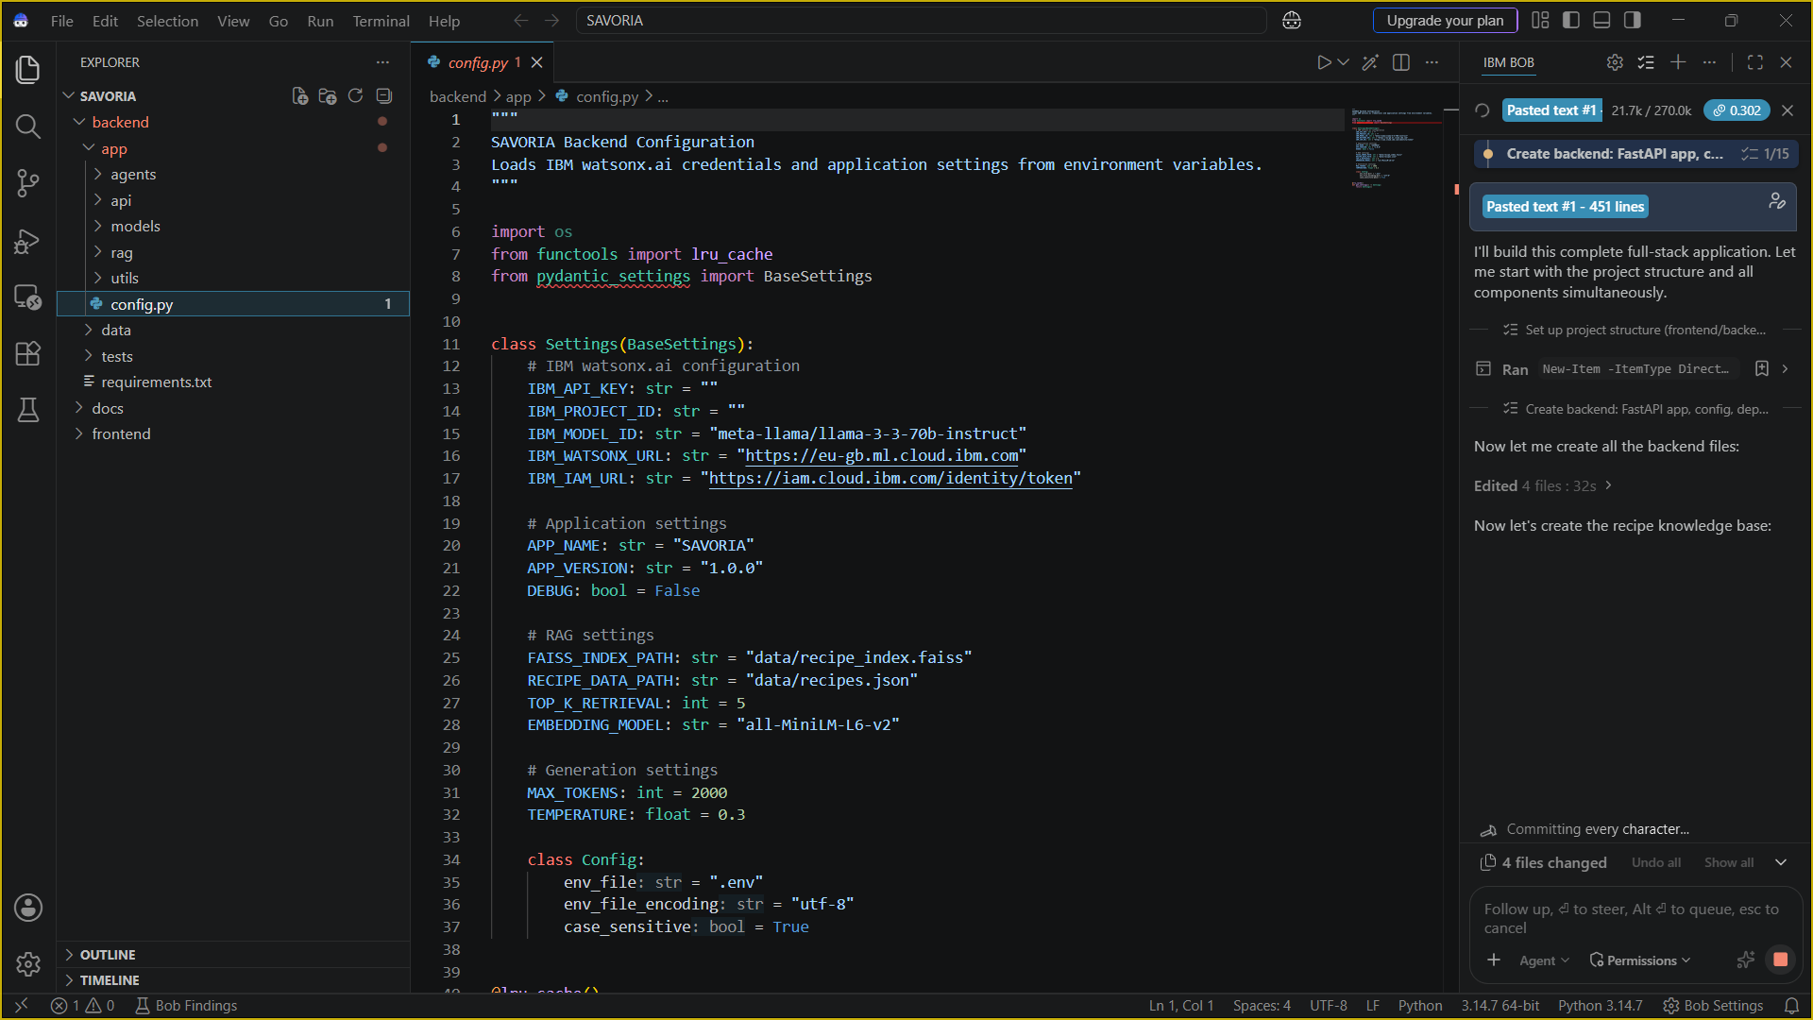
Required Files created using IBM bob -

Slide 7
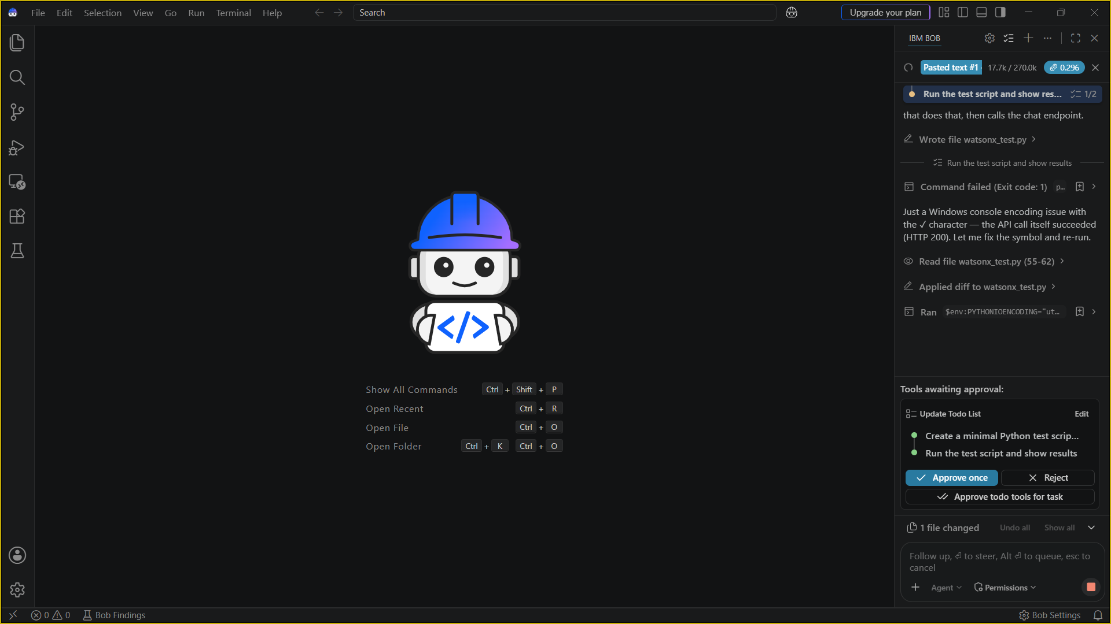
IBM Bob Screenshots:

Slide 8
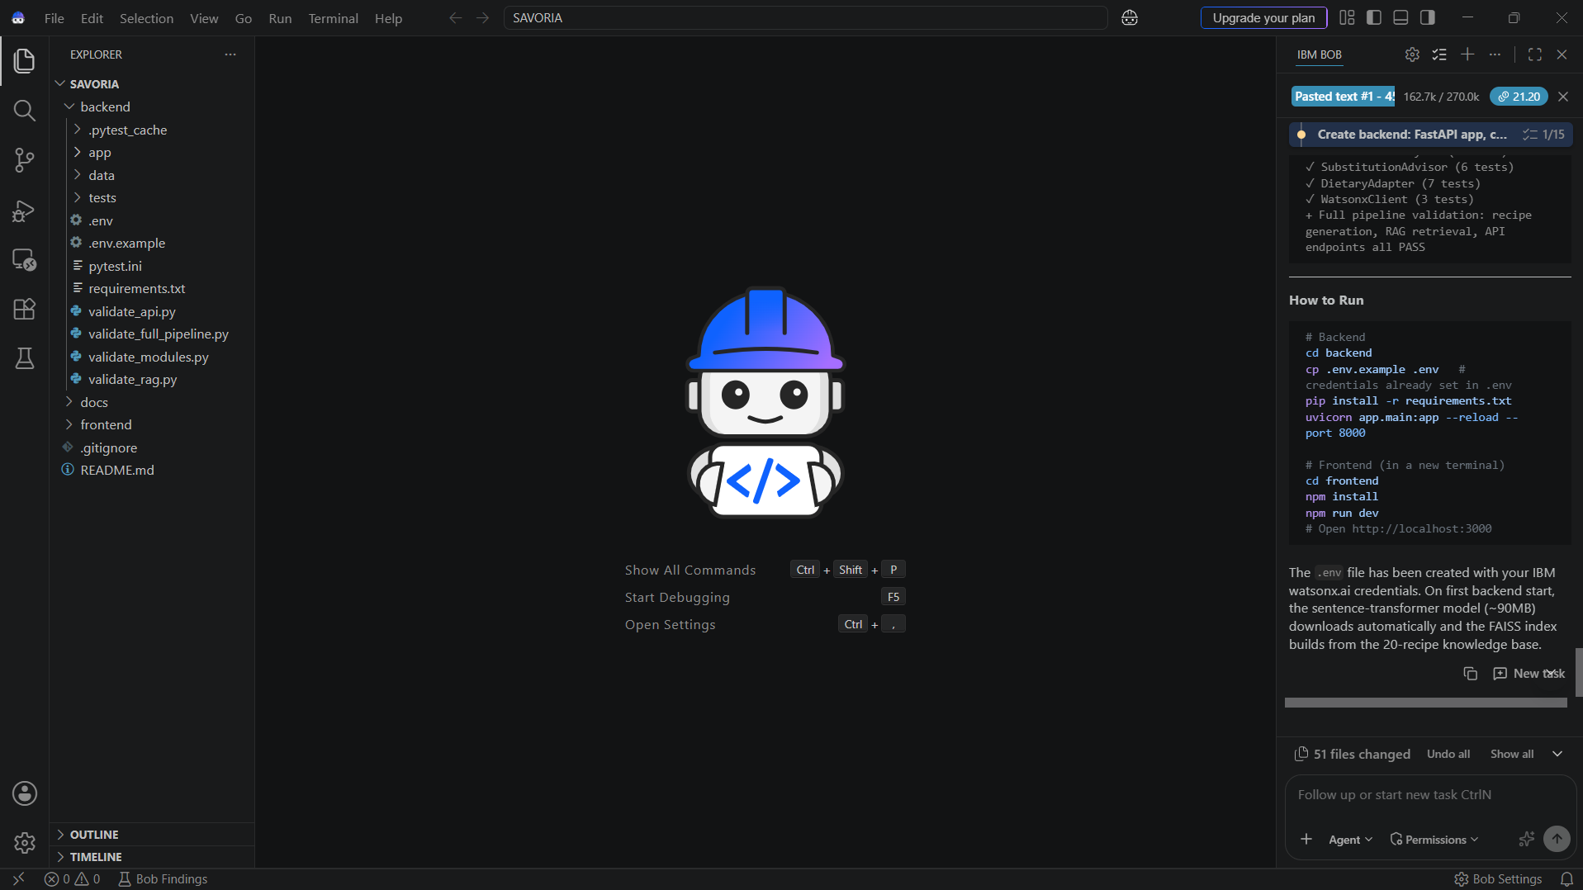

Slide 9
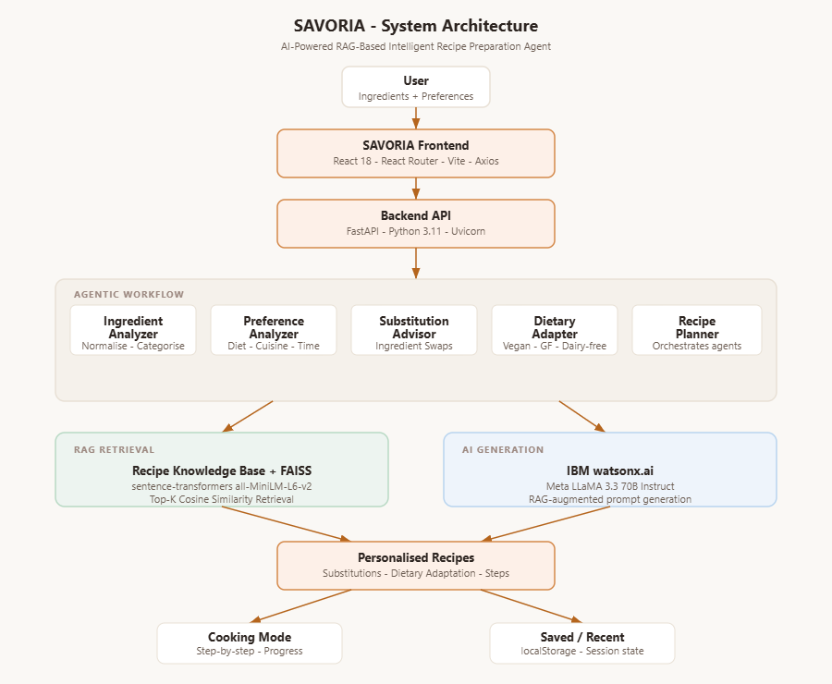
Architecture blueprint for IBM bob:

Slide 10

Role of Agentic AI in the solution
ROLE OF AGENTIC AI IN SAVORIA
Agentic AI enables SAVORIA to function as an intelligent recipe preparation system rather than a simple recipe search tool.
It analyzes the user's available ingredients, preferences, dietary requirements, and cooking constraints to determine the most suitable meal options.
KEY ROLES
• Ingredient Analysis
Understands available groceries and identifies usable ingredients.
• Intelligent Retrieval
Retrieves relevant recipes and cooking knowledge using RAG.
• Recipe Planning
Determines suitable meals based on ingredients, preferences, and constraints.
• Personalized Generation
Generates step-by-step recipes adapted to the user's requirements.
• Substitution Assistance
Recommends alternatives for unavailable ingredients.
• Dietary Adaptation
Adjusts recipes according to dietary preferences and restrictions.
• Context-Aware Decision Making
Combines retrieved knowledge with user context to provide practical meal solutions.
Overall, Agentic AI makes SAVORIA adaptive, personalized, and goal-oriented, helping users transform available ingredients into practical meals while reducing food waste.

Slide 11
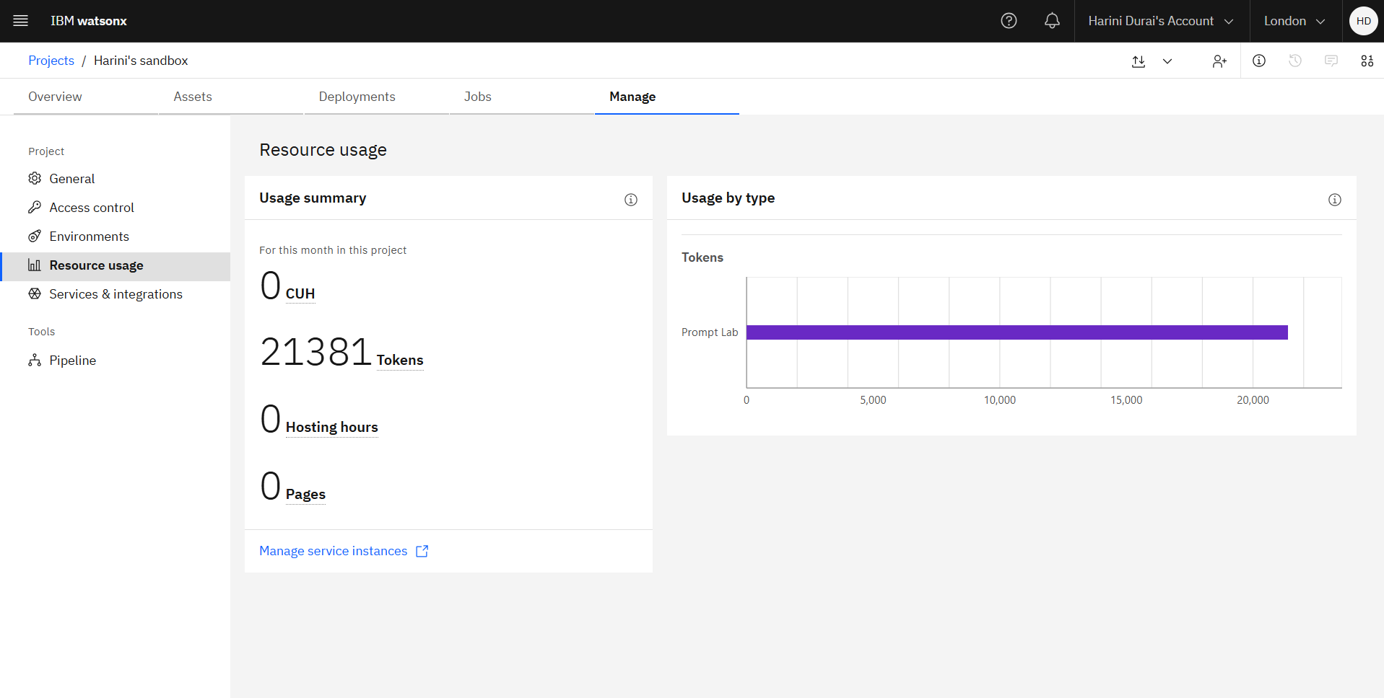
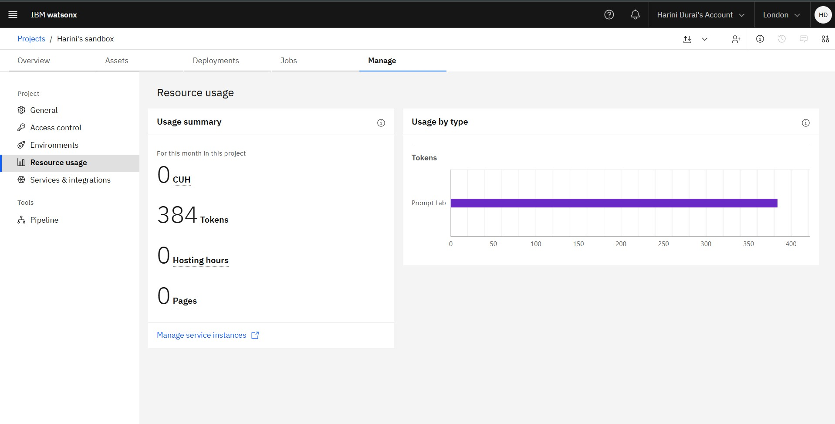
Token Usage
Before Prompt
After the Prompt
·
·
·

Slide 12
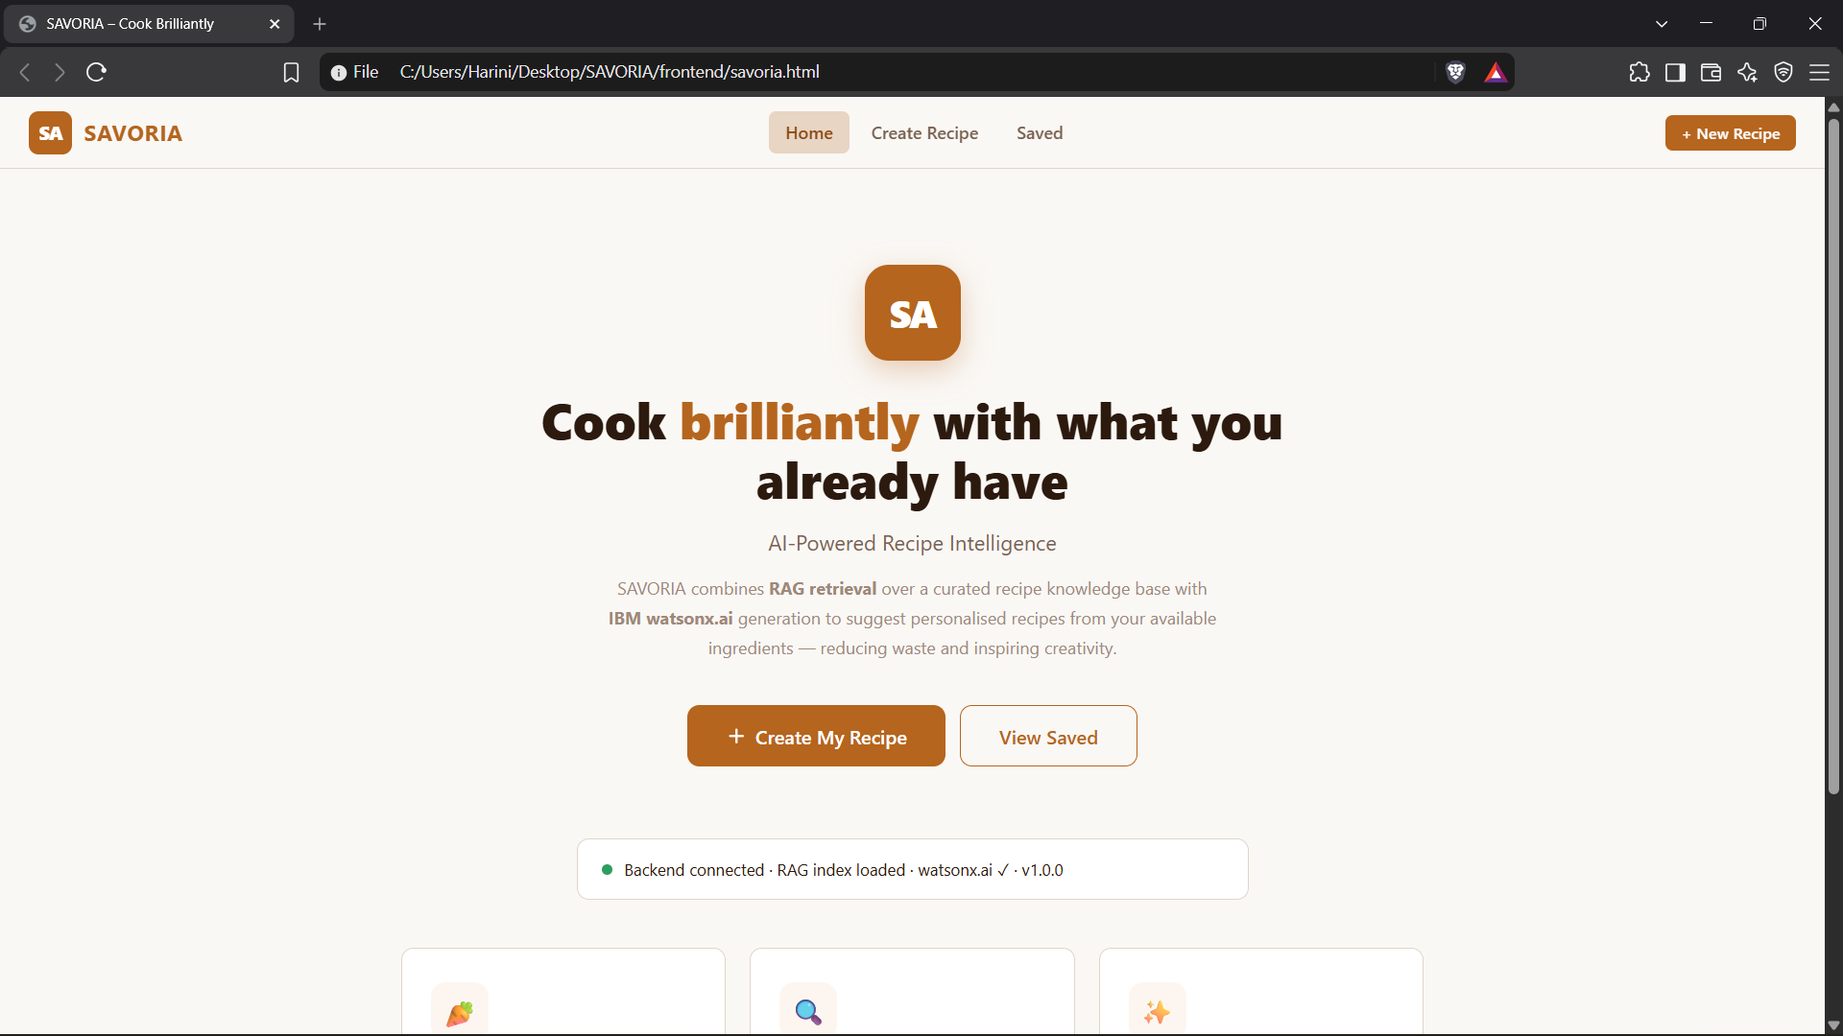
Project Output Screenshot
Please put IBM Bob output screenshots with 2-3 prompts.
You can take 2-3 more slides for each screenshot
·
·
·

Slide 13
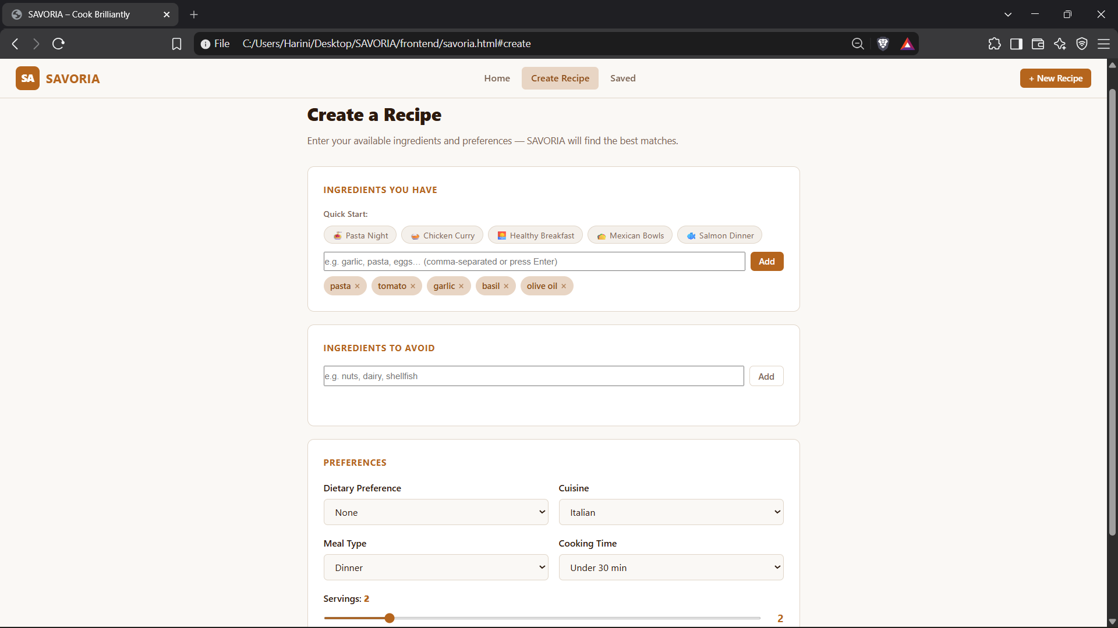
Project Output Screenshot
Please put IBM Bob output screenshots with 2-3 prompts.
You can take 2-3 more slides for each screenshot
·
·
·

Slide 14
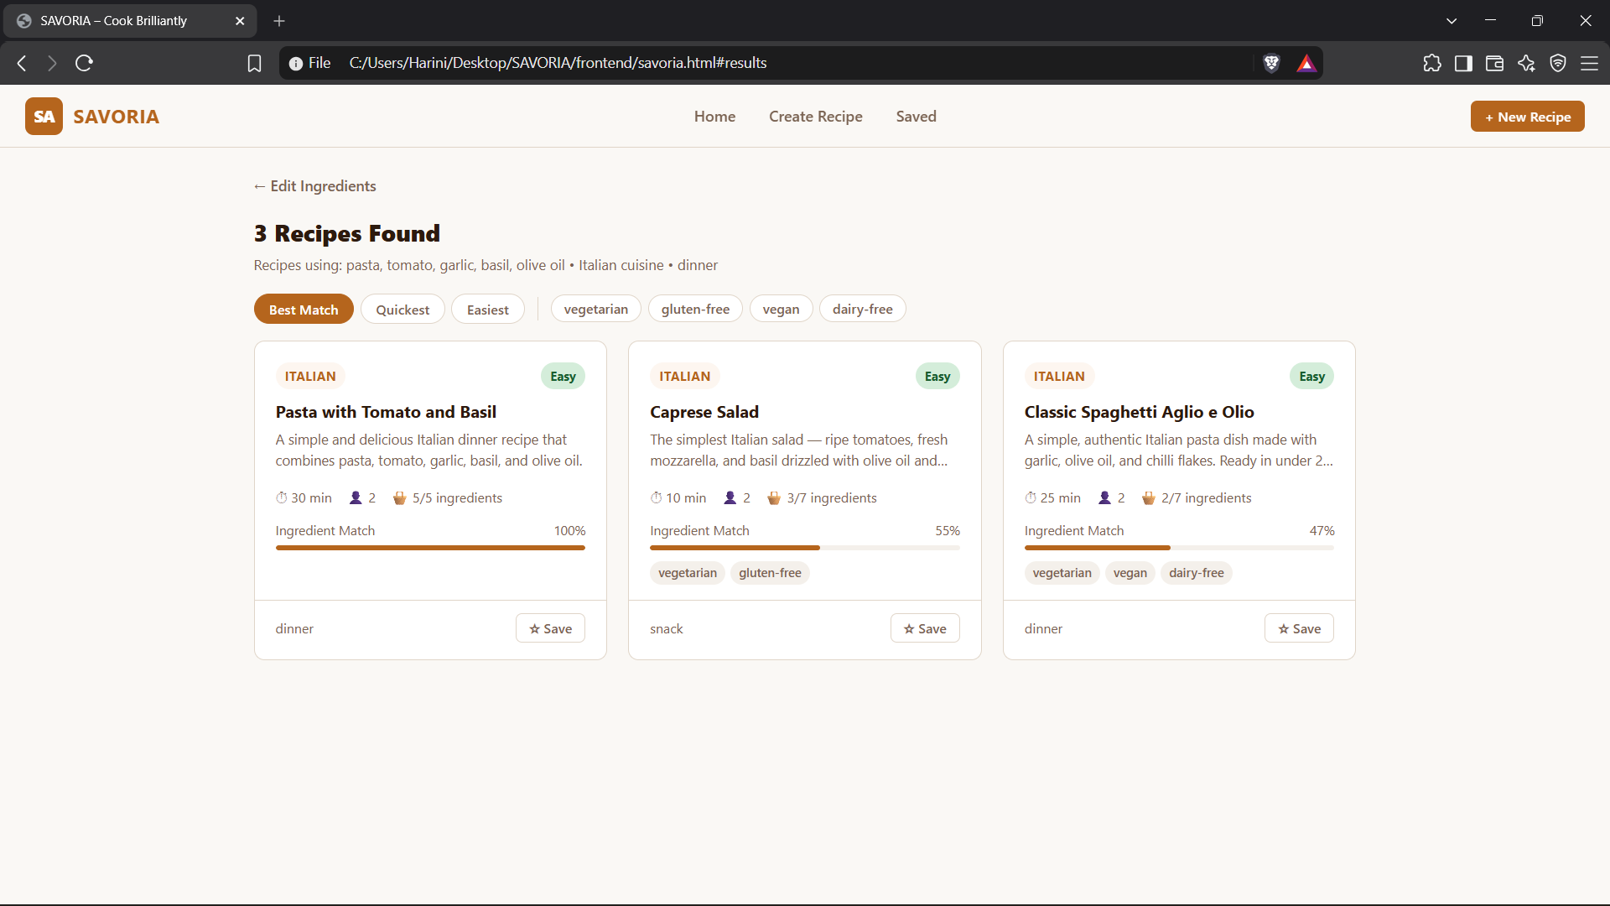
Project Output Screenshot
Please put IBM Bob output screenshots with 2-3 prompts.
You can take 2-3 more slides for each screenshot
·
·
·

Slide 15
Novelty and Uniqueness
SAVORIA combines RAG, Agentic AI, and ingredient-based personalization to create an intelligent meal preparation experience.
• Ingredient-First Intelligence
Generates practical recipes based primarily on ingredients already available to the user.
• RAG-Based Recipe Retrieval
Retrieves relevant recipe and cooking knowledge before generating recommendations.
• Personalized Recipe Adaptation
Adapts recipes according to dietary preferences, cuisine, meal type, cooking time, and servings.
• Smart Ingredient Substitution
Suggests practical alternatives when required ingredients are unavailable.
• Food-Waste Reduction
Helps users make better use of existing groceries instead of requiring completely new ingredients.
• Context-Aware Meal Planning
Combines user preferences, available ingredients, and retrieved recipe knowledge to produce relevant meal solutions.
• Interactive Cooking Experience
Converts generated recipes into a structured step-by-step cooking mode.
This makes SAVORIA more than a recipe search application — it is a personalized, adaptive, and ingredient-aware recipe preparation system.

Slide 16
Git Hub Link
· Please create public github repository (Enable Add README button while creating repository) with format –
Please test and Paste the working Github URL –https://github.com/harini621-exe/SAVORIA
Make sure you have Uploaded following three files into your github repository
1) All Agent relevant files of IBM Cloud , 2) yourproblemstatement.pdf file 3) your projectpresntation.pptx file 4)any other files
·
·
·

Slide 17
Future Scope
1. Image-Based Ingredient Recognition
Identify available ingredients from uploaded grocery images.
2. Voice & Multilingual Support
Enable hands-free cooking assistance and recipe instructions in multiple languages.
3. Personalized Meal Planning
Generate multi-day meal plans based on ingredients, preferences, and dietary requirements.
4. Smart Kitchen Integration
Connect with smart kitchen devices for cooking timers, alerts, and automated assistance.
·
·
·

Slide 18
Certificates Earned:
Please add your credly certificate(Getting Started with Artificial Intelligence)

Slide 19
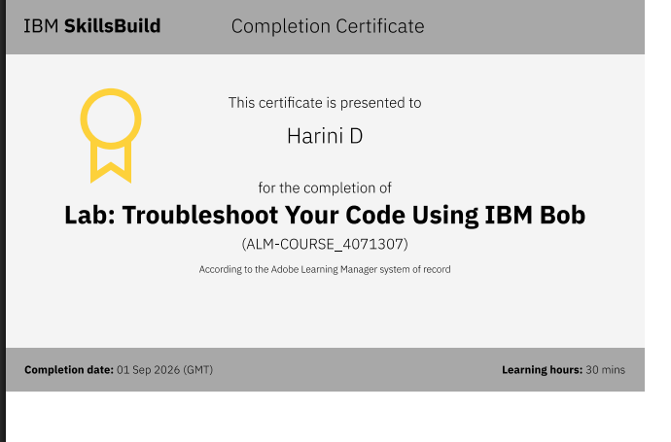
Certificates Earned:​
Add your IBM BOB Certificate

Slide 20


